Slide 1


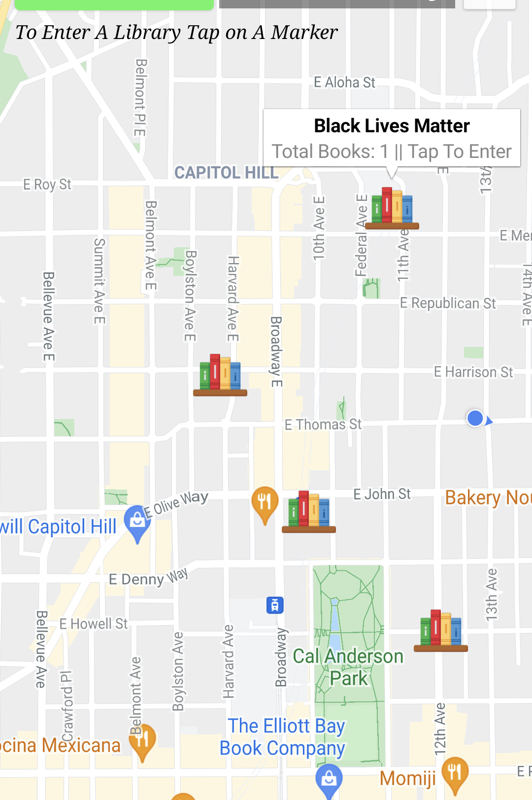

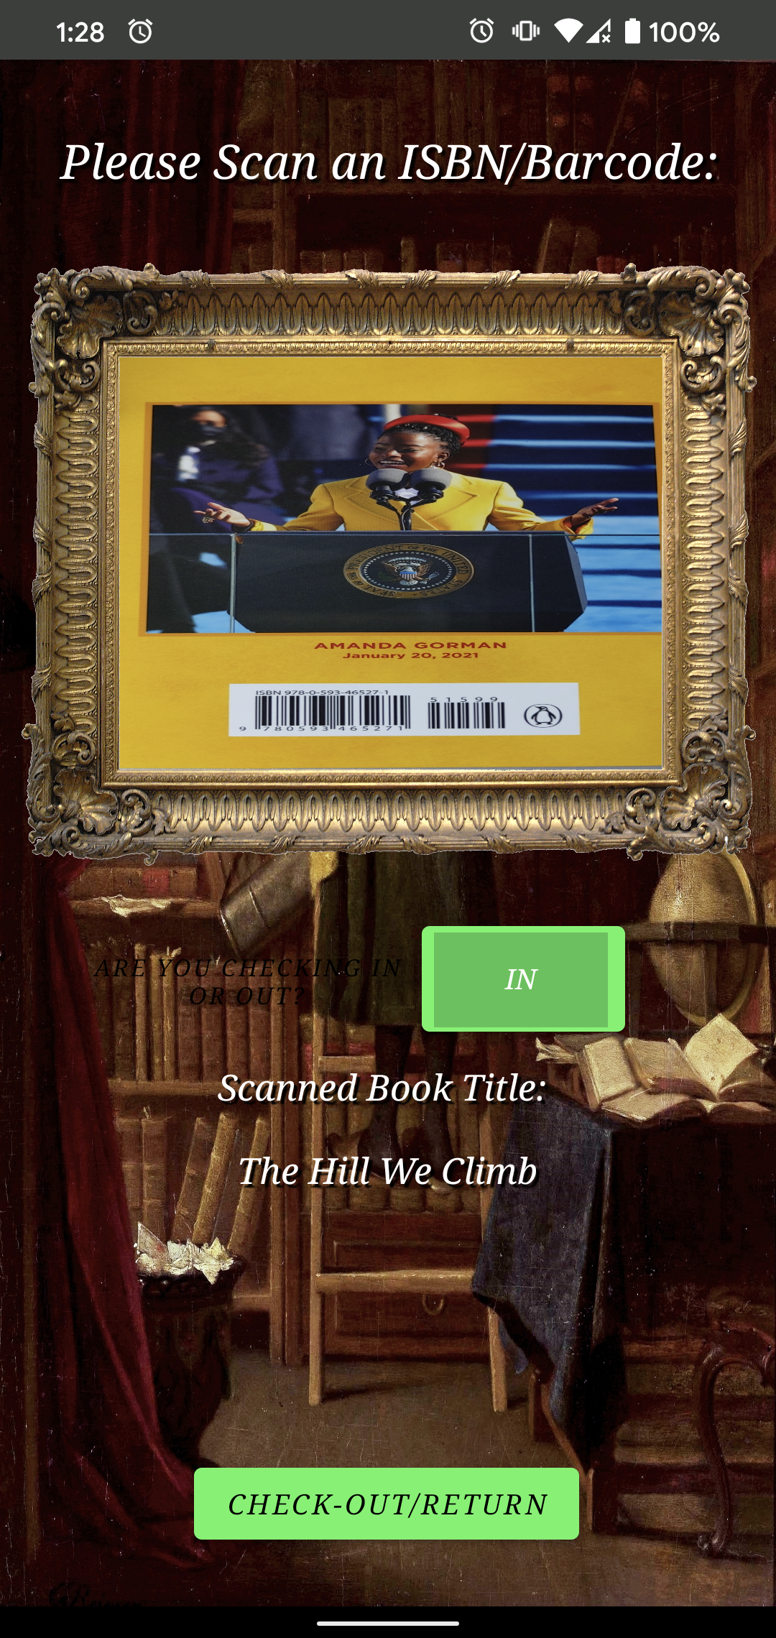
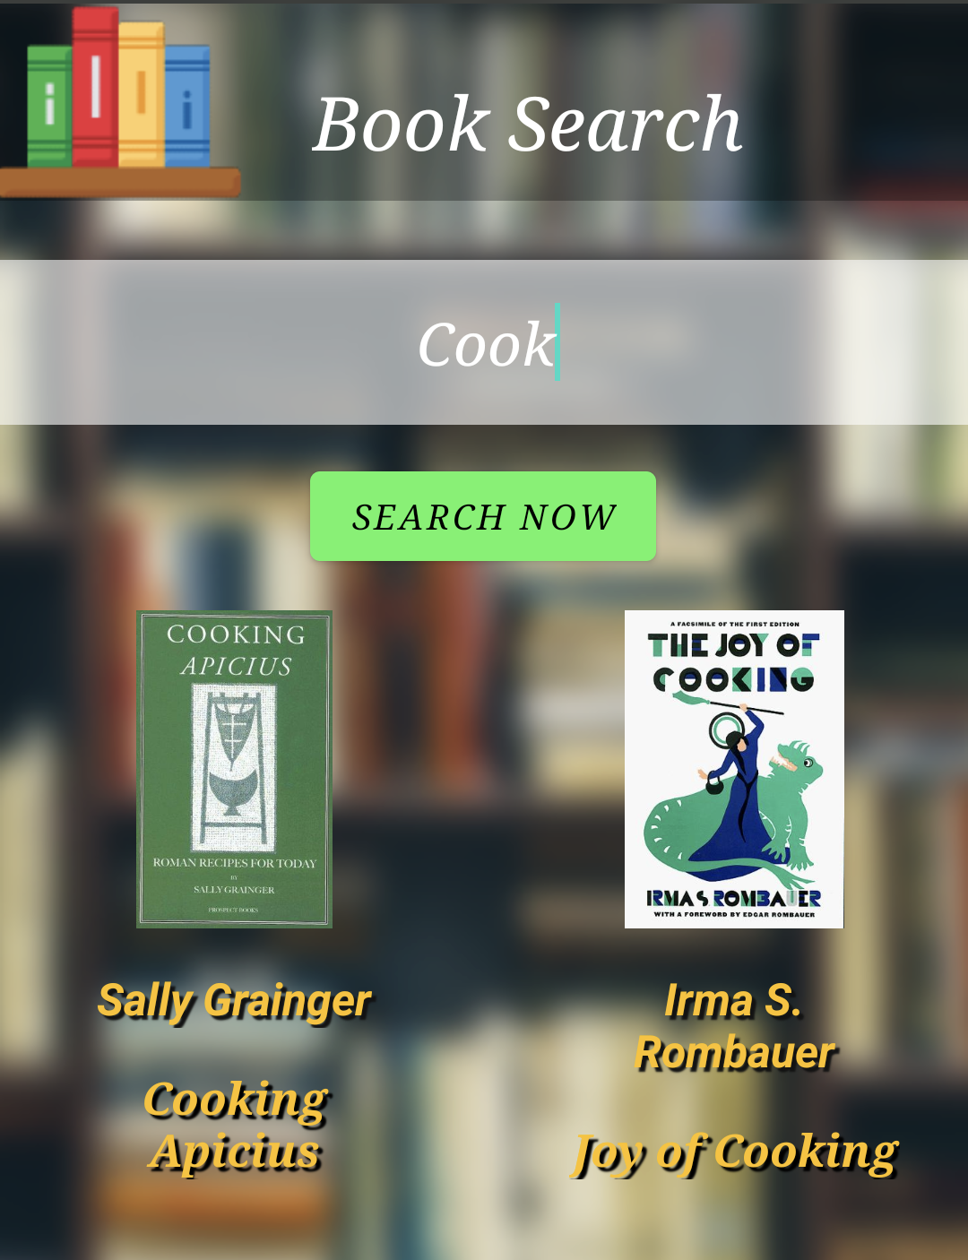


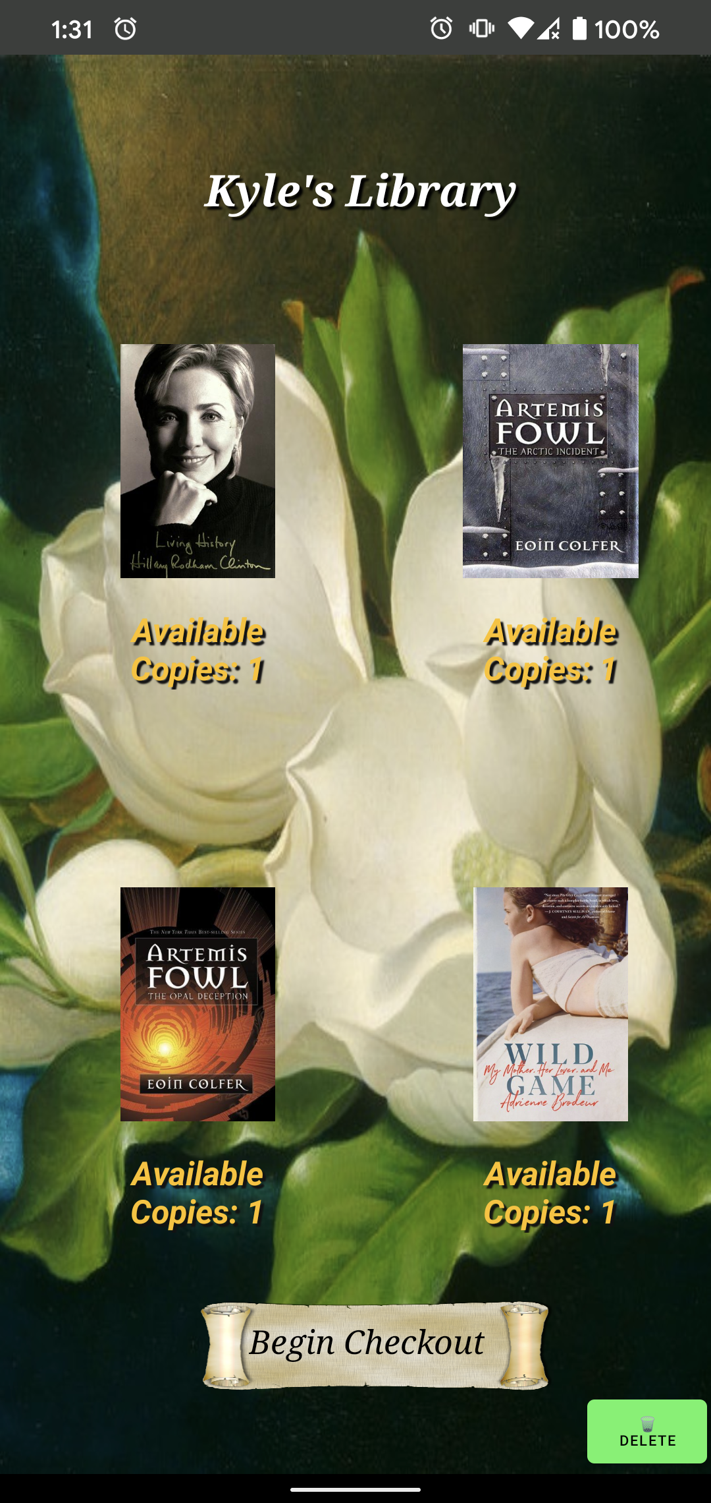






SO MANY BOOKS, SO LITTLE TIME…
ARE YOU CHECKING IN
OR OUT?
LEND YOUR BOOKS
READ MORE BOOKS
NAVIGATE YOUR NEIGHBORHOOD
… ALL FROM YOUR PHONE
LIBRAWORKS
VIRTUAL LIBRARY
FIRST EDITION: JUNE 2021
ADVISER: ZHIYUN LI
GRANT SAYLOR KYLE SMITH ANTHONY TRAN JIAYI XU

